Slide 1
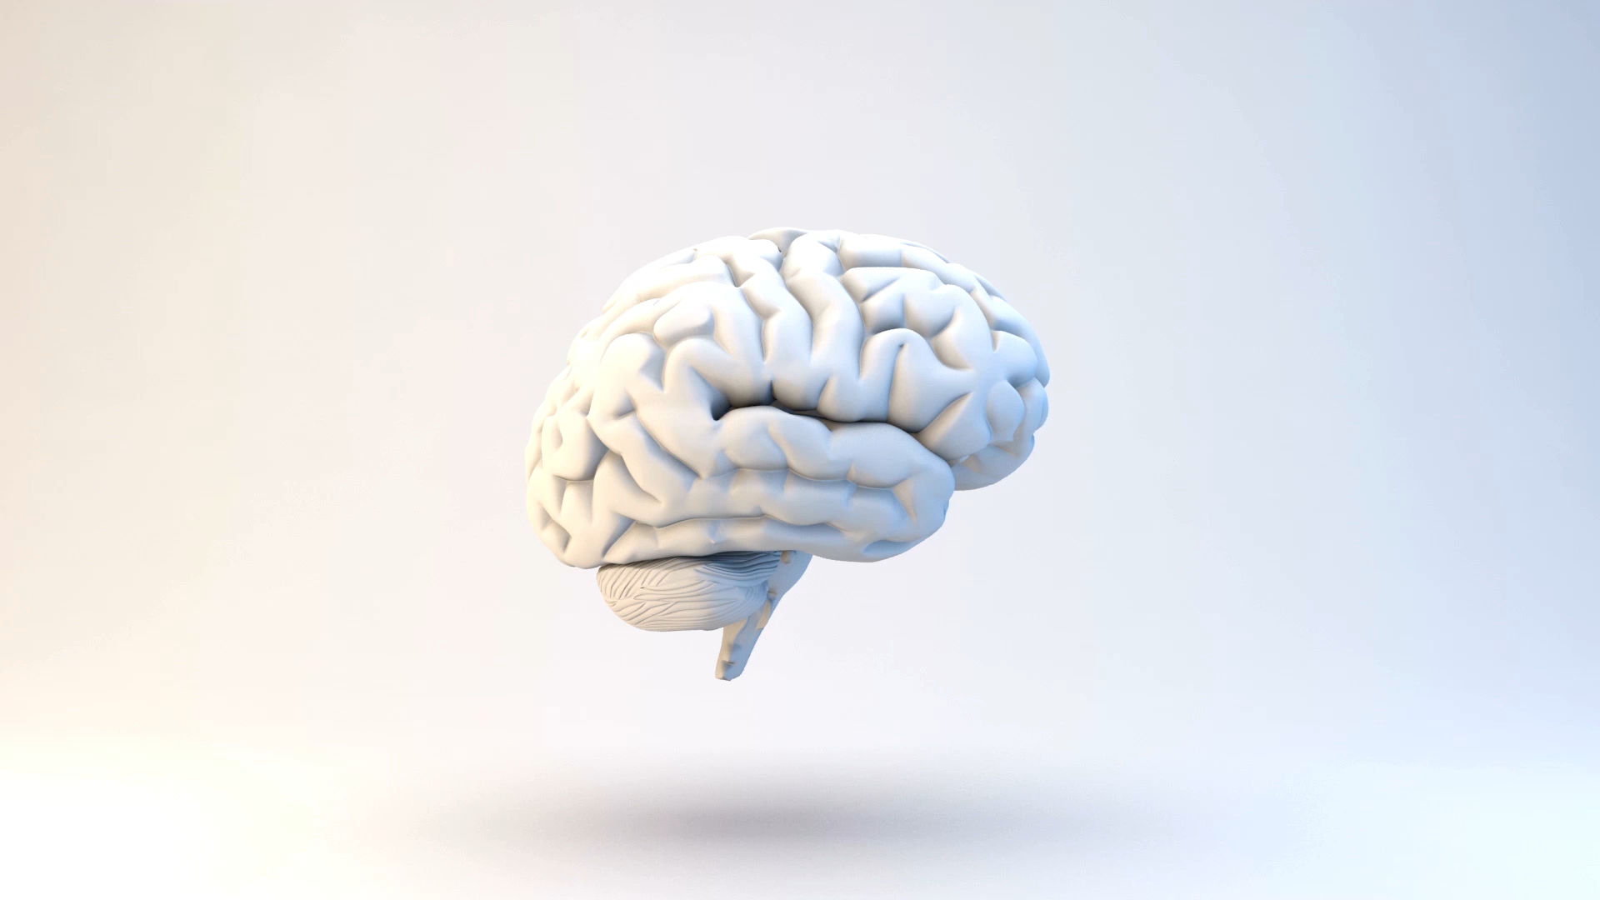
Brain Computer Interface(BCI)
Project under guidance of Mrs. Akansha Gupta
Presented By: Karan Agarwal

Slide 2
Introduction to BCI
Brain-Computer Interface is a system that allows users to interact with the computer, where the device predicts the abstract aspects of cognitive state with brain signals such as Electroencephalography (EEG). This system, also called Brain-Machine Interface (BMI), is often combined with an AI-powered algorithm that allows users to harness brain states to execute instruments such as speller programs, wheelchairs, virtual games, and other assistive devices.

Slide 3
Steps to make a BCI
Signal acquisition
Pre-processing
Feature Extraction
Classification
Translation
Feedback device

Slide 4
Objective of this project
To overcome the pathological shortcomings of the human body, such as neuromuscular disorders, through technology.
Helping motor deficit patients by using the neuroplastic through BCI.
I have taken the approach of utilizing deep learning algorithms in order to attempt to reduce time delay caused by software or algorithms.
Numerous algorithms and traditional approaches were investigated, computationally accurate the algorithms failed to show robust performance in real-world scenarios.
Main reason for this was the delay between real-time learning and execution of physical tasks like moving an arm in a direction.
This drawback can be bested by focusing on more complex deep learning networks which are proven to be faster than traditional approaches and become more accurate with parameter and code optimization due to their flexible computational structure.

Slide 5
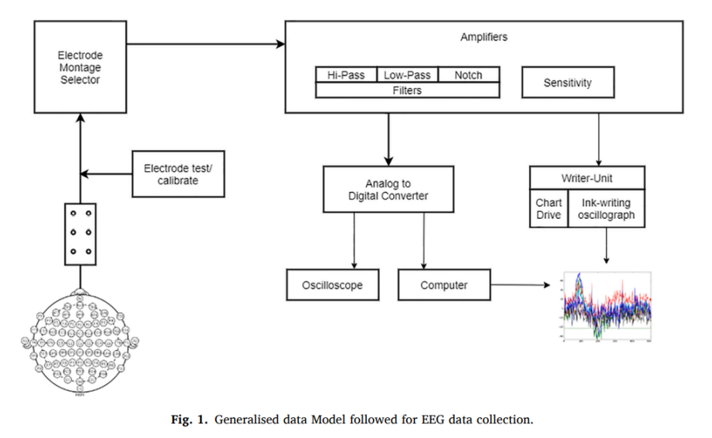
Data Acquisition and Analysis
This dataset is obtained from CNGB Sequence Archive (CNSA) which contains EMG dataset of 52 subjects, location of the 3D EEG electrodes.

Slide 6
Research Methods
Support Vector Machine (SVM): The goal of the SVM algorithm is to create the best line or decision boundary that can segregate n-dimensional space into classes so that we can easily put the new data point in the correct category in the future. This best decision boundary is called a hyperplane.
Random Forest Classifier: Random forest, which is an ensemble of the Decision Trees, that can be more accurate and efficient in dealing with large scale data and has the ability to overcome overfitting problem of decision trees. Random forest algorithms usually introduce additional randomness while growing trees. Instead of searching for best parameters while node splitting, it searches for best parameters from a random subset of features resulting in greater tree diversity and higher bias to lower variance trade. This process results in an overall better model for classification.
Gradient Boost Classifier: In Gradient Boosting, each predictor tries to improve on its predecessor by reducing the errors. But the fascinating idea behind Gradient Boosting is that instead of fitting a predictor on the data at each iteration, it actually fits a new predictor to the residual errors made by the previous predictor.

Slide 7
Software Requirement Specification
Libraries Used:
NumPy: It for Numerical Python, is a library consisting of multidimensional array objects and a collection of routines for processing those arrays. Using NumPy, mathematical and logical operations on arrays can be performed.
Pandas: Pandas is an open-source Python package that is most widely used for data science/data analysis and machine learning tasks.
Sklearn: Sklearn library contains a lot of efficient tools for machine learning and statistical modeling including classification, regression, clustering, and dimensionality reduction
Matplotlib: Matplotlib is a cross-platform, data visualization and graphical plotting library for Python and its numerical extension NumPy.

Slide 8
Languages Used:
Python: Python is an interpreted high-level general-purpose programming language. Its design philosophy emphasizes code readability with its use of significant indentation. Its language constructs and object-oriented approach aim to help programmers write clear, logical code for small- and large-scale projects.
MATLAB: MATLAB is a proprietary multi-paradigm programming language and numeric computing environment developed by MathWorks. MATLAB allows matrix manipulations, plotting of functions and data, implementation of algorithms, creation of user interfaces, and interfacing with programs written in other languages

Slide 9
Limitations of BCI
Signal acquisition hardware
Difficult to decode the signal
Pose risks for the patient health
The theory of being able to read minds
Legal Implications

Slide 10
Future of BCI
Facebook started hiring Brain Computer Interface Engineers and neural imaging engineers in April 2017, to work on a 2-year B8 project using machine learning and neuroimaging. The plan is to use optical imaging for scanning the brain to detect the speaking in the head and translate it into text.
Elon Musk’s Neuralink was publicly launched in March 2017. The announcement was made the day after Facebook announced its BCI project. Elon Musk has referred few times to a “neural lace”, an AI layer which would augment human brain’s abilities. In a detailed report on the website Wait but why, they refer to it as a “Wizard Hat”. It would be a “third layer” which would complement the other two: the limbic system and the cortex. The main idea of its creator is to build implantable devices to help humans keeping up with the raise of Artificial intelligence.

Slide 11
Further Enhancement of the Project
Nowadays, several brain signals such as Steady-State Visual Evoked Potential (SSVEP), P300 evoked potential is employed for motor function rehabilitation.
If the patient has an injury in the brain (e.g., stroke), the function of damaged part of the brain can be transferred to another part of the brain based on the demand to produce recovery of behavioral or physiological processes (i.e., brain reorganization).
A robotic arm is the most promising application of our algorithm because of its deterministic output about motor development. The robotic arm together, with our algorithm, can mimic the functions of the natural arm according to the classified outputs.
Self-independent rehabilitation robots which exploit neuroplasticity by a physiological limb muscle activation that can be achieved through functional arm/hand and leg movement exercises and the activation of appropriate peripheral receptors.

Slide 12

Thank you

